Slide 1
Graph Analysis - Friend Recommendation System
Himani Thakkar (ht2191)
Hrituja Khatavkar (hk3219)

Slide 2
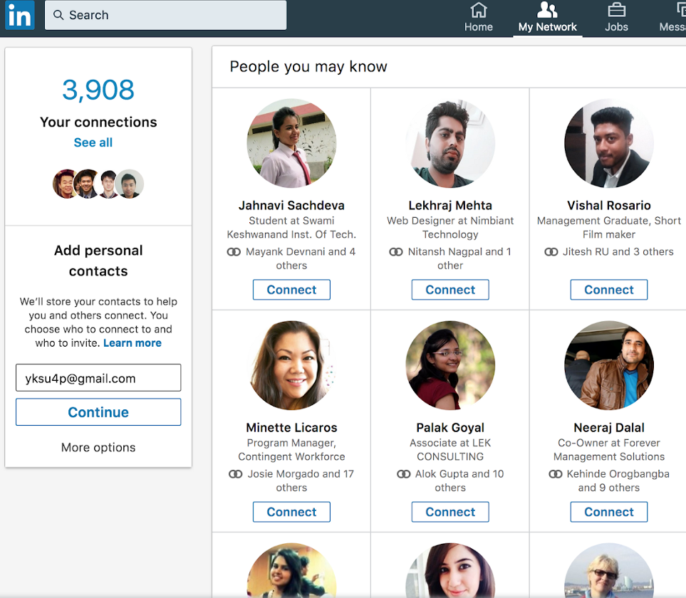
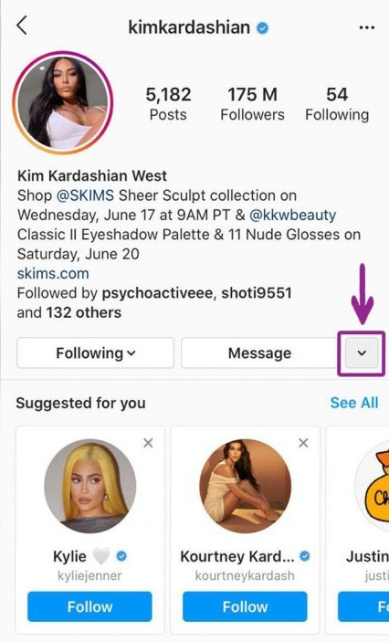
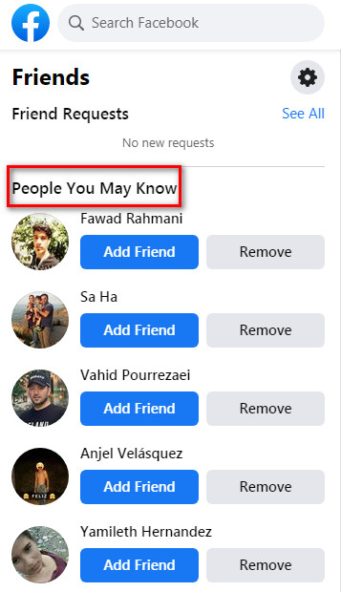
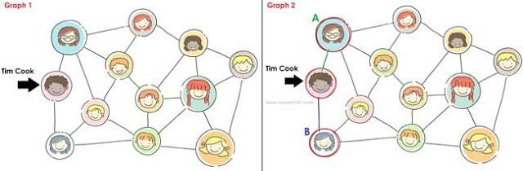
Introduction
Today, we see various social media platforms offer a feature that suggests new connections and recommends pages/people based on a user and its attributes.
Having such a system in place, not only allows people to connect with one another easily but also facilitates businesses to maximize their social influence.
In our project, we are trying to replicate this feature by performing graph analysis to predict missing connections as recommendations.

Slide 3
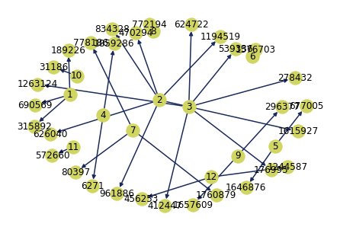
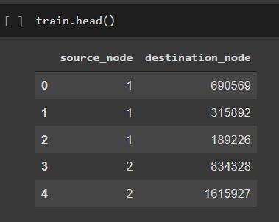
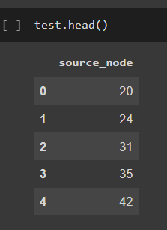
DataSet
Our data is obtained from Facebook’s recruiting challenge on Kaggle. https://www.kaggle.com/c/FacebookRecruiting
Our dataset is a directed graph consisting of 1.86M nodes and 9.44M edges.
Directed Graph

Slide 4

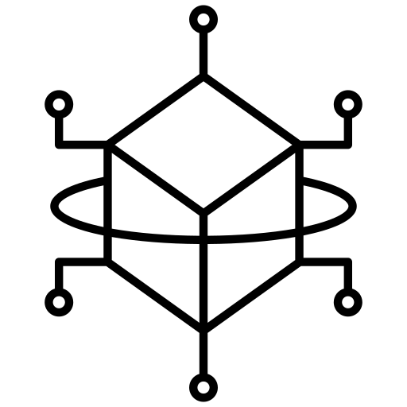
Methodology
Exploratory Data Analysis
Prep Code
Feature Engineering
Modeling
The idea is to experiment with data and see the what features and attributes it has.
We are then going to find out missing edges in the graph and split our training dataset to train and test with an 80-20 split.
We then use the source node and destination node to calculate a number of features between them, for eg: if they follow each other back, what is the shortest path between them if they are assumed to not follow each other, what is the similarity between then and so on.
Finally, we use these features to predict whether a link between them exists or not. We are using a Random Forest Classifier which is simply a forest of decision trees to help predict a link.

Slide 5
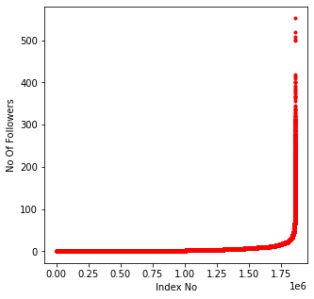
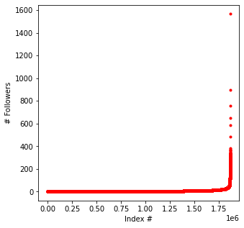
Exploratory Data Analysis: Lets Experiment with data

Slide 6
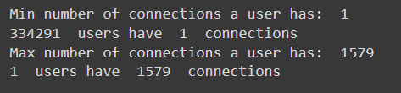
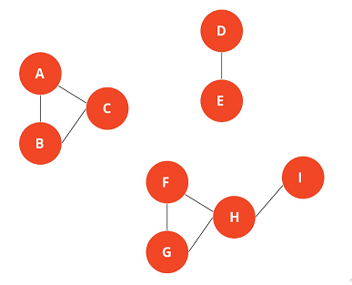

Exploratory Data Analysis: Lets find out how well connected the graph is
What are Weakly Connected Components ?

Slide 7
Feature Engineering
Once we have a gist of what the data is, we now build some features for our model to train on.
We have computed following features :
Weakly Connected Graph
HITS Score
Cosine distance
Follows Back?
Page Rank

Slide 8
Model Training
Random Forest
After mapping all the features for the train and test data, we then train our model using Random Forest Classifier.
We can then use this trained model to predict if an edge is present.
Random forest is a classification algorithm.
It consists of a large number of individual decision trees that operate as an ensemble.
Each individual tree in the random forest spits out a class prediction the class with the most votes becomes our model’s prediction

Slide 9
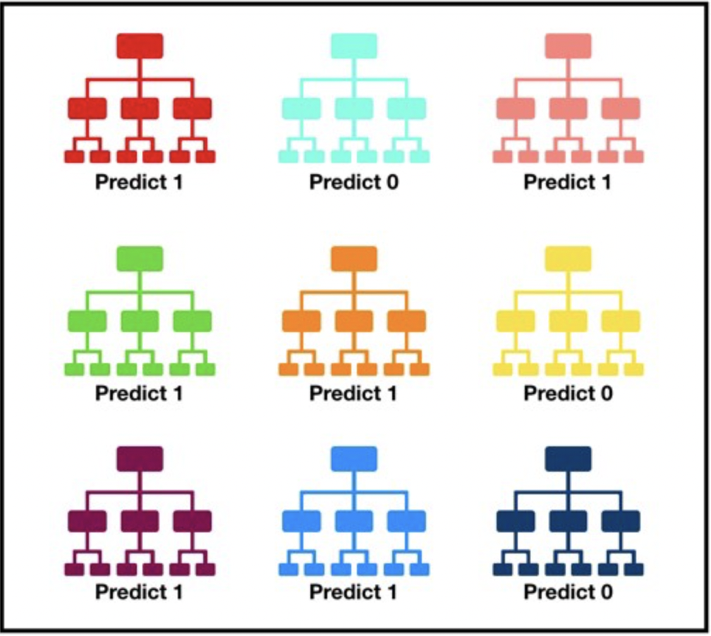
Why Random Forest?
It gives a higher accuracy through cross validation.
Random forest classifier can handle the missing values and maintain the accuracy of a large data.
If there are more trees, it doesn’t allow over-fitting trees in the model.
It has the ability to work on a large data set with higher dimensionality.
For our project, since the data is huge, random forest was the best choice

Slide 10
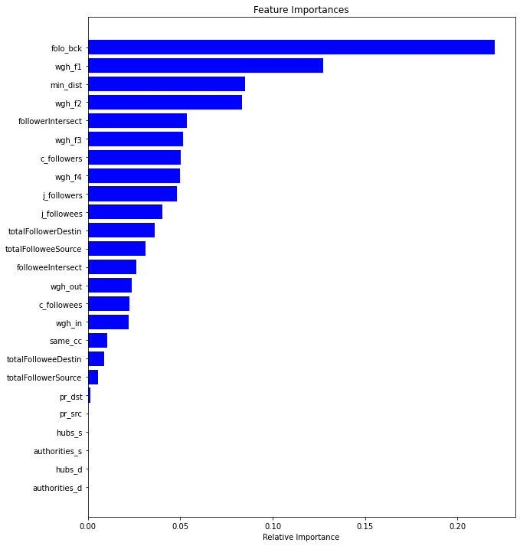
Conclusion
After predictions we try to conclude about the features that influence the most on our model and the following is the results that we obtain.

Slide 11
Future Scope
This system can be extended to find the nth connection like in LinkedIn and hence even further improve it’s prediction.
Metadata of the nodes for example demographics of a user can also be used in improving the results
Further link analysis algorithms like the The SALSA Algorithm and Randomized HITS can also be used to compare the result.

Slide 12


